Slide 1

DIP 2013 – Smart Fast Forward for Video Surveillance
r01922064 | 楊涵傑
d01922031 | 薛德明
B99902059 | 黃冠豪

Slide 2
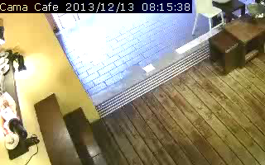
Smart Fast Forward Concept

Slide 3
Processing Stage Overview
Multi-Threaded!
OpenCV
Decoder
Background
Subtraction
Video
Frame Sequence

Slide 4
Processing Stage Overview
Multi-Threaded!
OpenCV
Decoder
Background
Subtraction
Object Detection
Video
Object Tracker
Frame Sequence

Slide 5
Processing Stage Overview
Multi-Threaded!
OpenCV
Decoder
Background
Subtraction
Object Detection
Video
Object Tracker
Distance metric!
(not matrix!)
Frame weight
estimation
Frame Sequence

Slide 6
Processing Stage Overview
Multi-Threaded!
OpenCV
Decoder
Background
Subtraction
Object Detection
Player Input
Video
Object Regions & Labels
Object Tracker
Frame weight
estimation
Frame Sequence

Slide 7
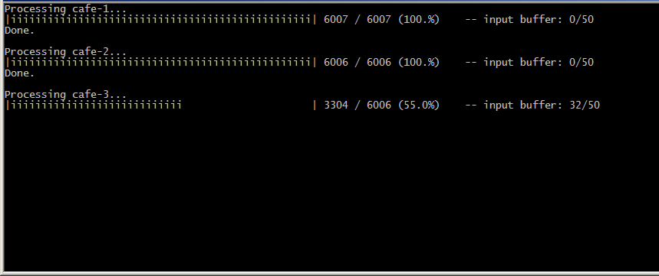
Processing Stage Processing...

Slide 8
Background Subtraction

Slide 9
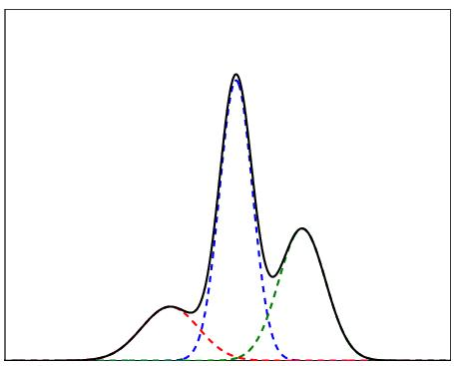
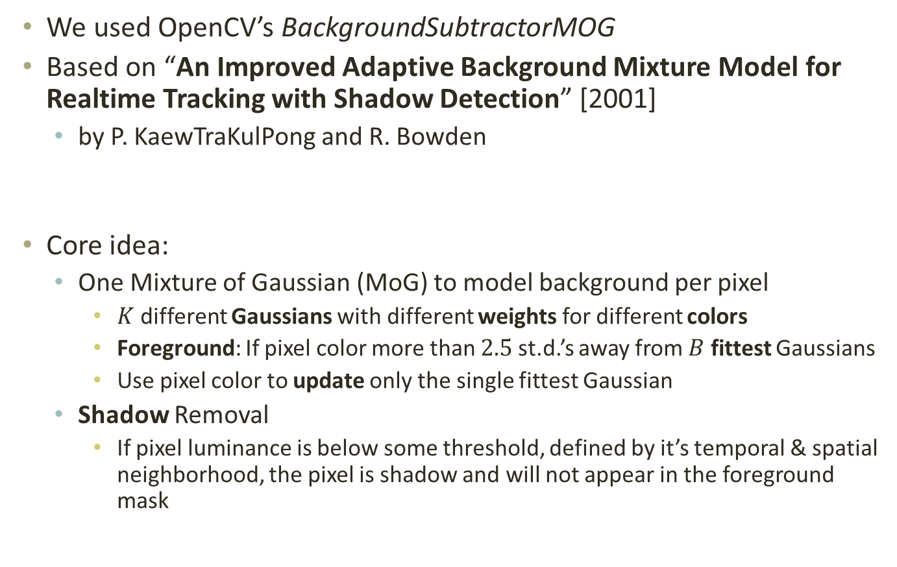
Background Subtraction MoG
We used OpenCV’s BackgroundSubtractorMOG
Based on “An Improved Adaptive Background Mixture Model for Realtime Tracking with Shadow Detection” [2001]
by P. KaewTraKulPong and R. Bowden
Core idea:
One Mixture of Gaussian (MoG) to model background per pixel
$K$ different Gaussians with different weights for different colors
Foreground: If pixel color more than $2.5$ st.d.’s away from $B$ fittest Gaussians
Use pixel color to update only the single fittest Gaussian
Shadow Removal
If pixel luminance is below some threshold, defined by it’s temporal & spatial neighborhood, the pixel is shadow and will not appear in the foreground mask

Slide 10
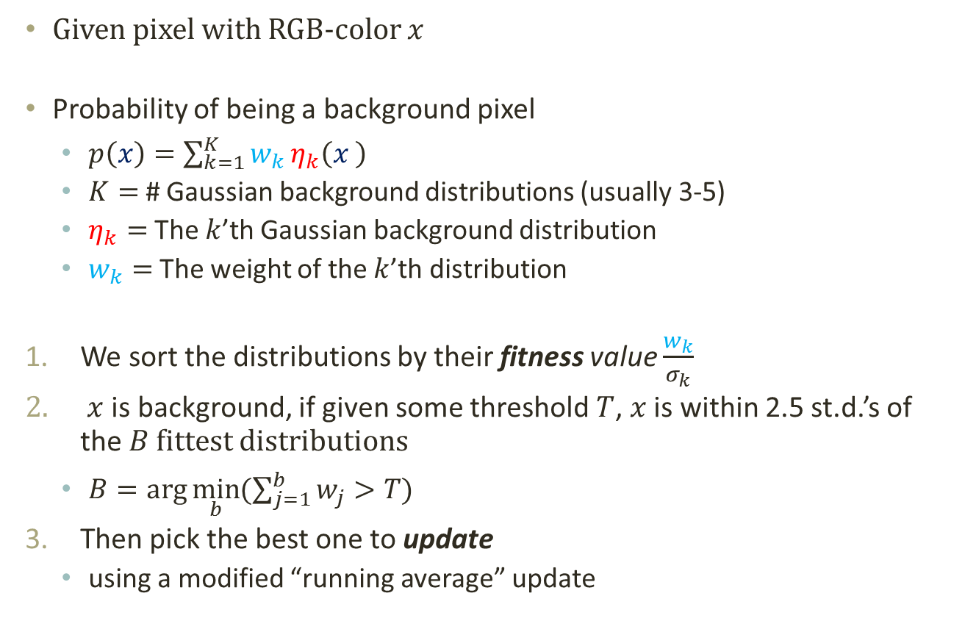
Background Subtraction MoG (Details)
Given pixel with RGB-color $x$
Probability of being a background pixel
$p\left(x\right)=\sum_{k=1}^{K}{w_{k}}η_{k}\left(x \right)$
$K=$ # Gaussian background distributions (usually 3-5)
$η_{k}=$ The $k$’th Gaussian background distribution
$w_{k}=$ The weight of the $k$’th distribution
We sort the distributions by their fitness value $\frac{w_{k}}{σ_{k}}$
$x$ is background, if given some threshold $T$, $x$ is within 2.5 st.d.’s of the $B$ fittest distributions
$B=\arg{\min_{b}{(\sum_{j=1}^{b}{w_{j}}>T)}}$
Then pick the best one to update
using a modified “running average” update

Slide 11
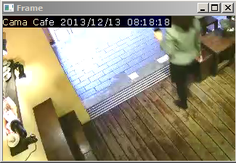
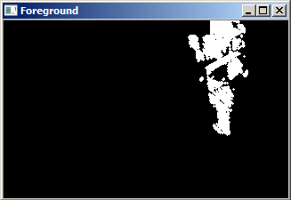
Background Subtraction Results

